Slide 1


Irradiance estimation from sky images for PV power prediction
Amrollah Seifoddini
Supervisors:
Prof. Marc Pollefeys Dr. Jan Poland
March 2016

Slide 2
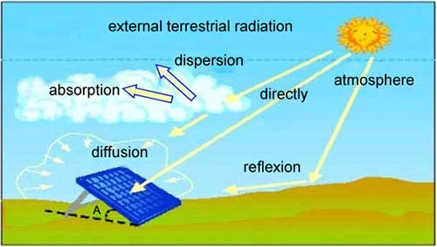
Motivation & goal
Sky imager based shortest-term solar irradiance forecasts for local solar energy applications

Slide 3
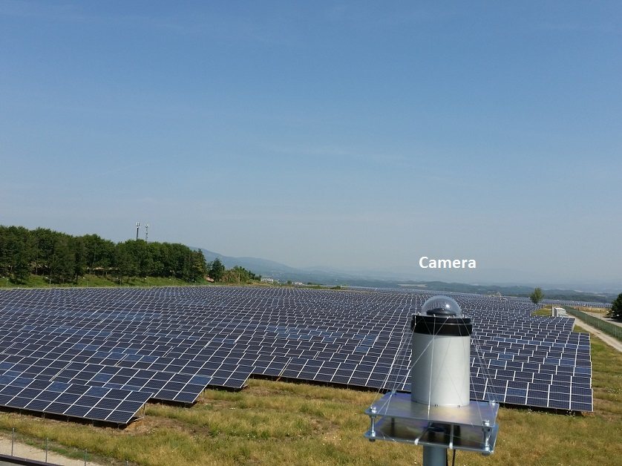
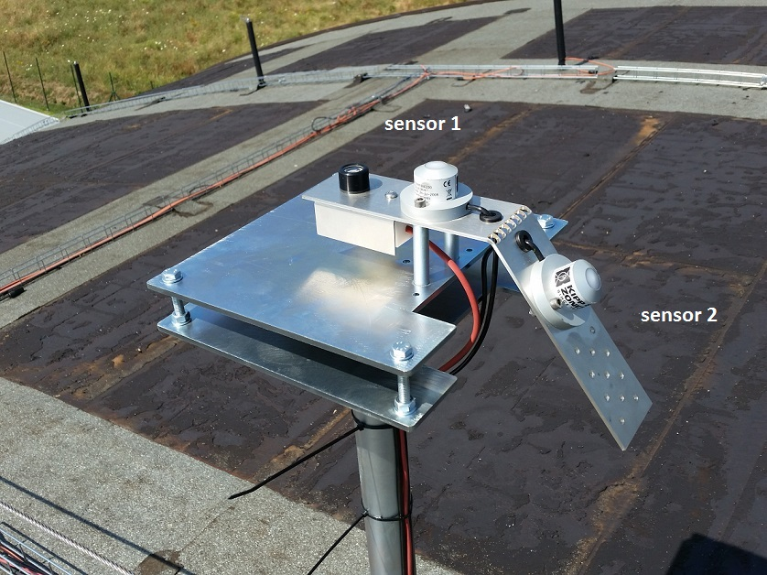
Experimental setup (in Cavriglia)

Slide 4
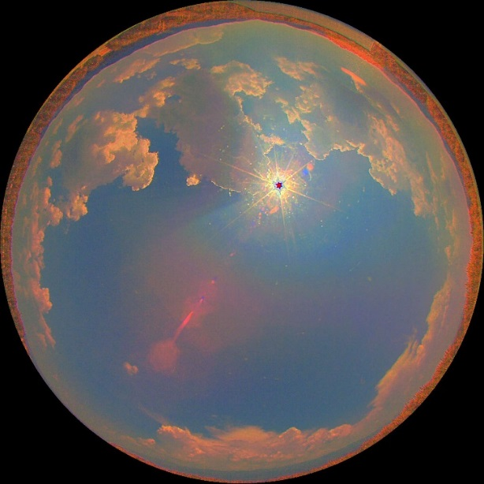
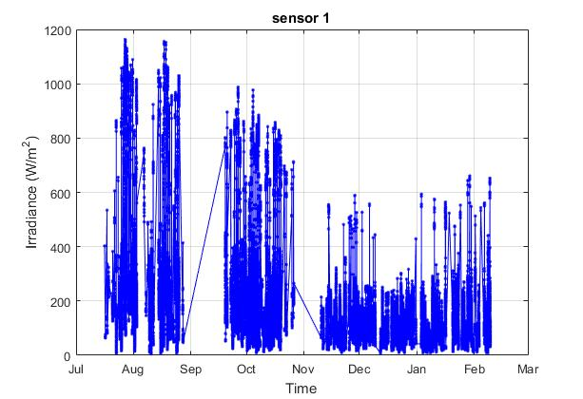
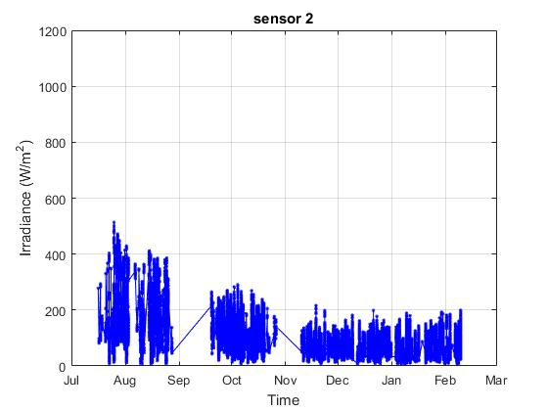
Acquired Data
HDR Images and Irradiance every 8 seconds
Power every 3 seconds

Slide 5
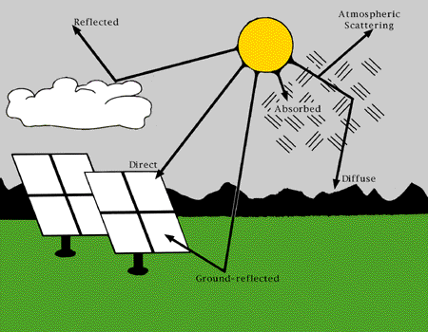
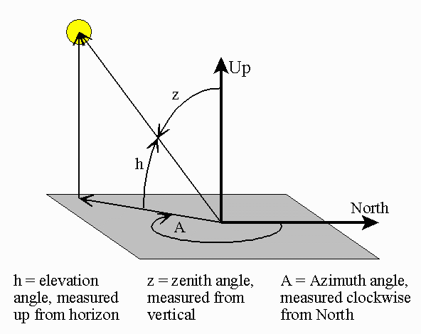

Irradiation components
Global Horizontal Irradiance (GHI)
Diffuse Horizontal Irradiance (DHI)
Direct Normal Irradiance (DNI)
$GHI=DNI ×\cos{(Z)}$ + DHI + reflected

Slide 6
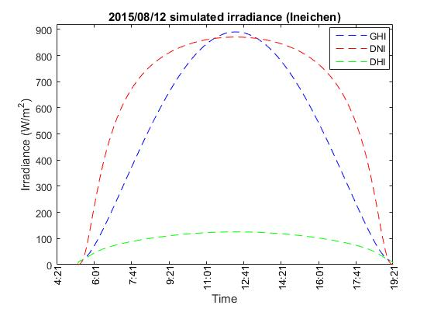
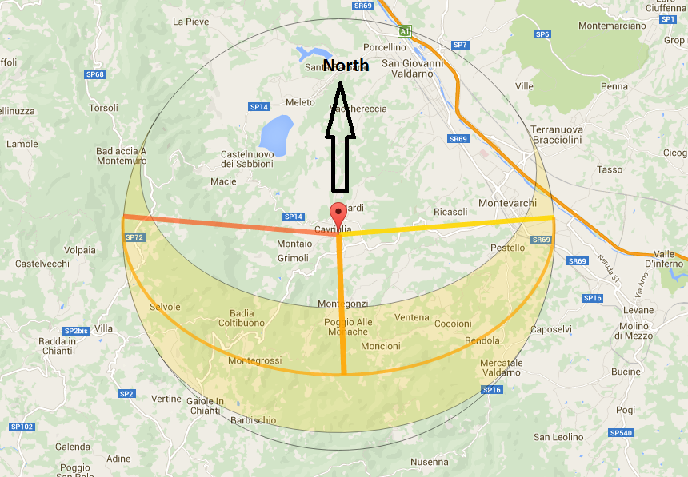
Irradiation components (cont.)

Slide 7
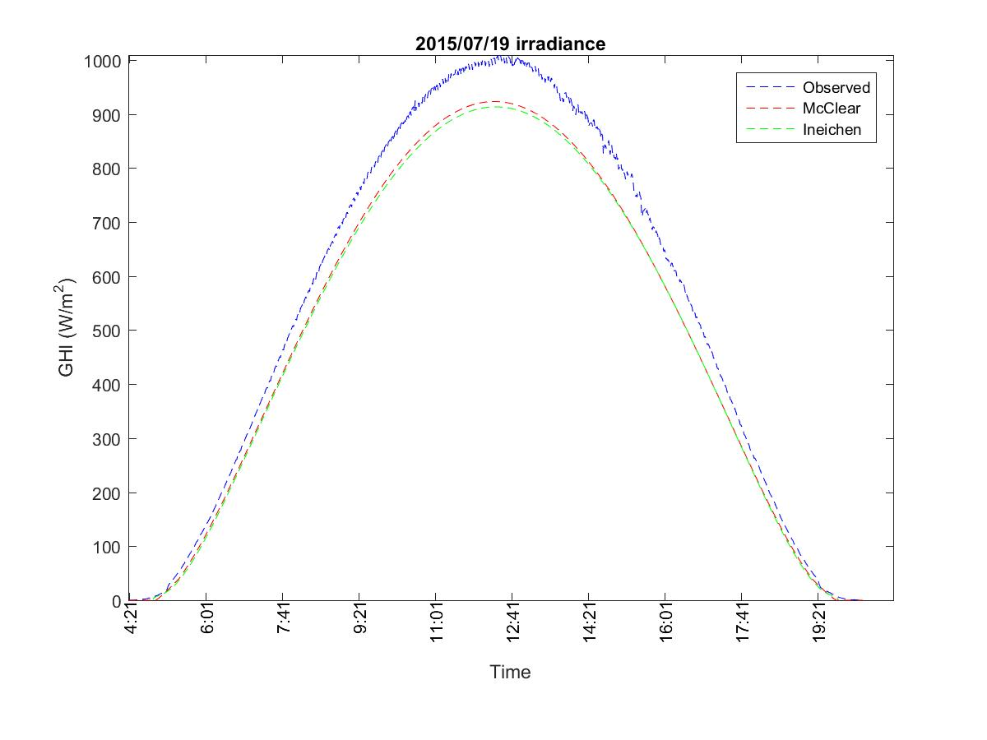
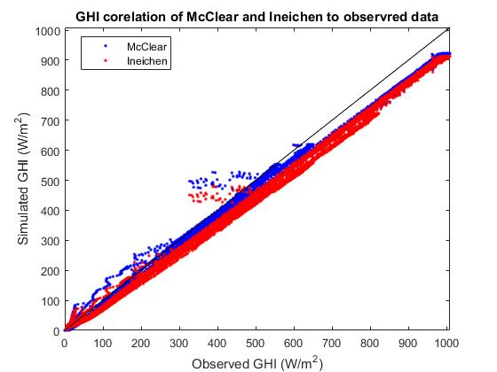
Clear-sky irradiance model

Slide 8
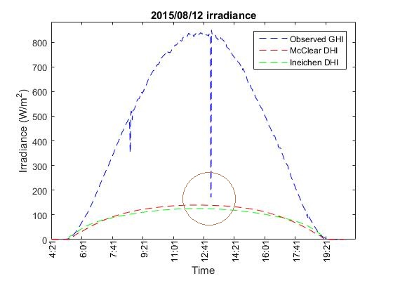
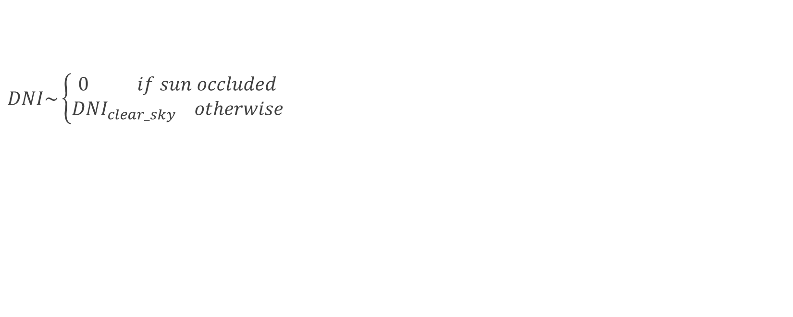

Estimating DNI (from clear-sky model)
$DNI\sim \left\{\begin{aligned}0 if sun occluded \\ {DNI}_{clear_sky} otherwise\end{aligned}\right.$
$GHI=DNI ×\cos{(Z)}$ + DHI

Slide 9
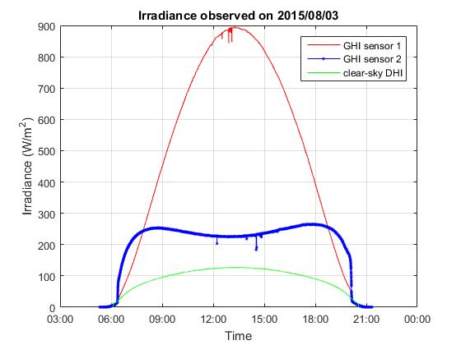
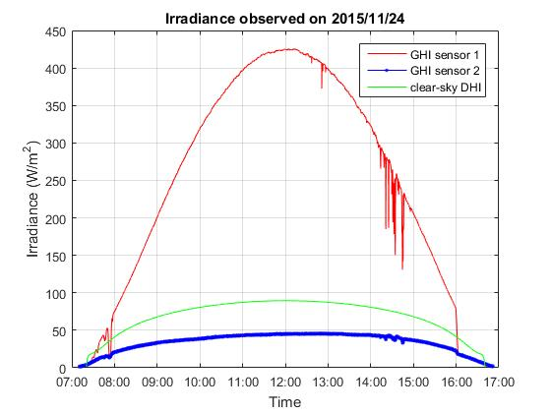
Estimating diffuse from sensors
Notes:
Using clear_sun_flag and estimated DNI for calculating diffuse from tilted plate
We only consider images with complete visible sun or no sun at all.
Extracted diffuse from north-facing plate is more robust than south-facing one

Slide 10
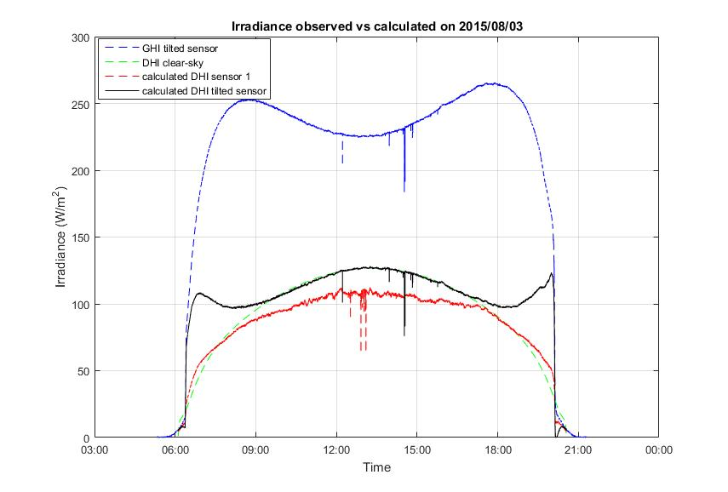
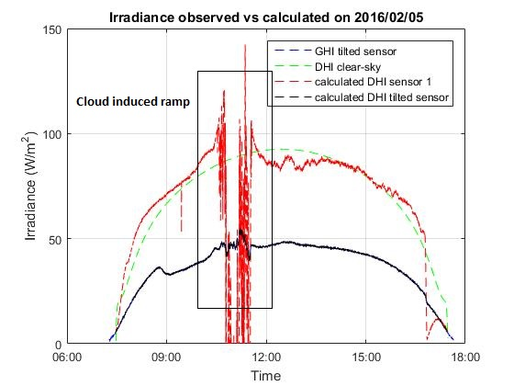
Estimating diffuse from sensors (cont.)
$$θ=Arctan2(\left\|a ⊗ b\right\|, a∙b)$$
Notes:
Using clear_sun_flag and estimated DNI for calculating diffuse from tilted plate
We only consider images with complete visible sun or no sun at all.
Extracted diffuse from north-facing plate is more robust than south-facing one

Slide 11
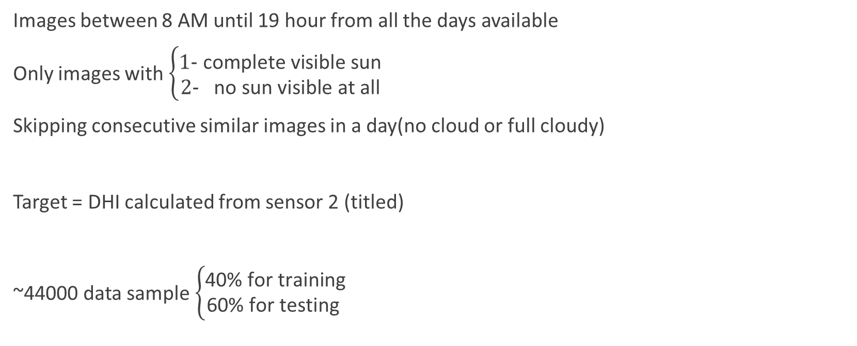
dataset
Images between 8 AM until 19 hour from all the days available
Only images with $\left\{\begin{aligned}\text{1- }\text{complete} \text{visible} \text{sun} \\ 2\text{- }\text{no} \text{sun} \text{visible} \text{at} \text{all}\end{aligned}\right.$
Skipping consecutive similar images in a day(no cloud or full cloudy)
Target = DHI calculated from sensor 2 (titled)
~44000 data sample $\left\{\begin{aligned}\text{40\% }\text{for} \text{training} \\ \text{60\% }\text{for} \text{testing} \end{aligned}\right.$

Slide 12
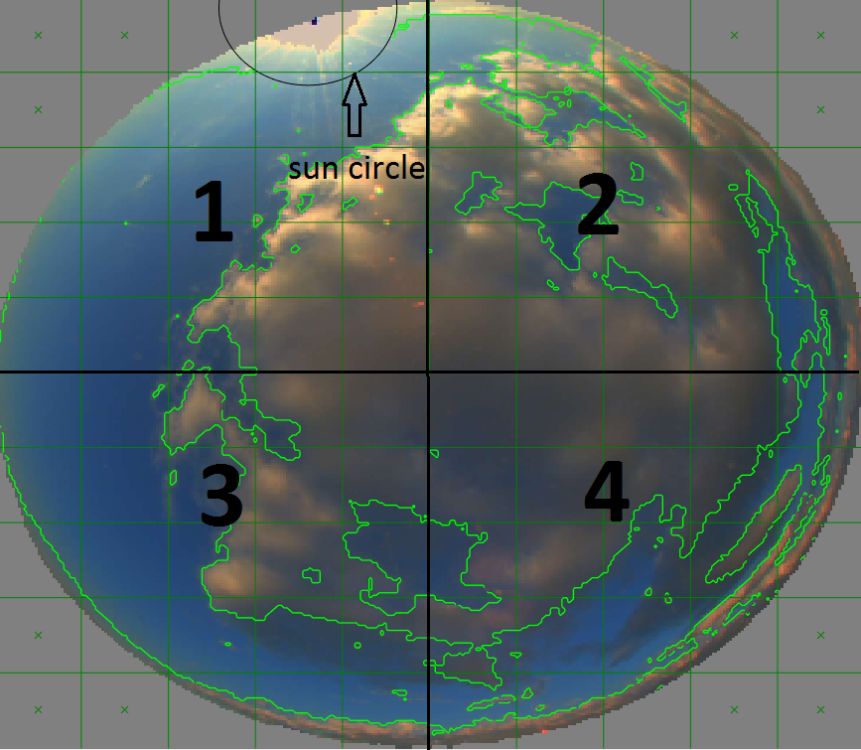
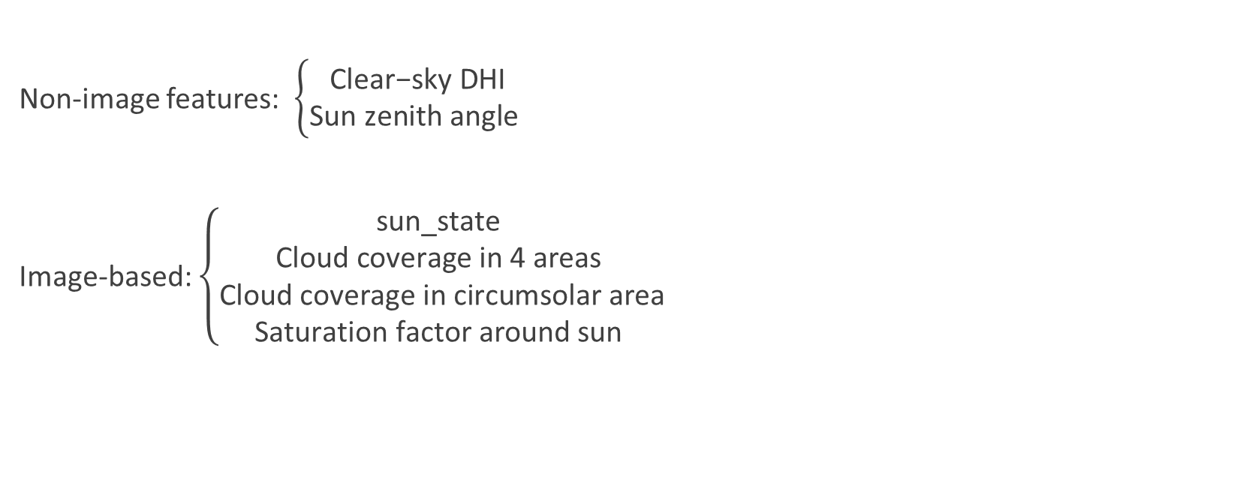
Estimating diffuse from Image features
Non-image features: $\left\{\begin{aligned}\text{Clear}\text{−}\text{sky} \text{DHI} \\ \text{Sun} \text{zenith} \text{angle} \end{aligned}\right.$
Image-based: $\left\{\begin{aligned}\text{sun}\text{_}\text{state} \\ \text{Cloud} \text{coverage} \text{in}\text{ 4 }\text{areas} \\ \text{Cloud} \text{coverage} \text{in} \text{circumsolar} \text{area} \\ \text{Saturation} \text{factor} \text{around} \text{sun} \end{aligned}\right.$

Slide 13
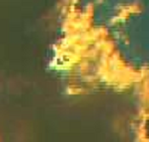
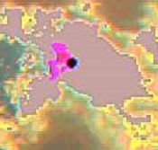
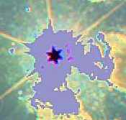
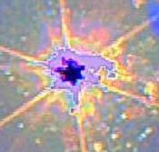
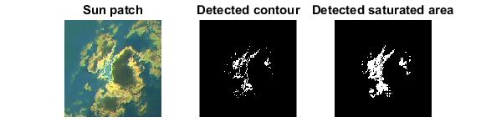
Features (cont.)
sun_state =
1
2
3
4
Saturation factor

Slide 14
Learning algorithms
K-nearest-neighbor regression
K=10
Support Vector Machine regression
RBF kernel
parameters cross-validated
Linear regression
With feature interactions

Slide 15
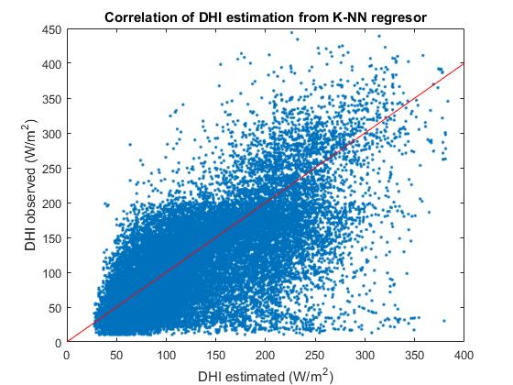
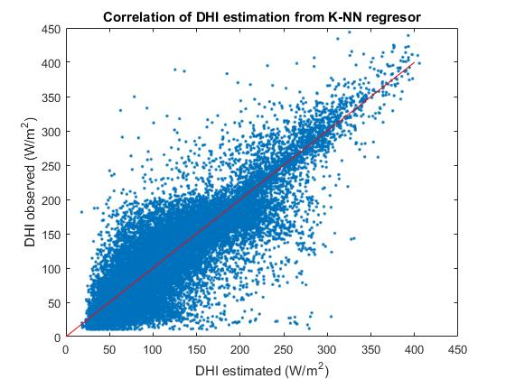
K-NN regression result
Non-image features:
RMSE = 57.2 W/m^2
All the features:
RMSE = 34.8 W/m^2

Slide 16
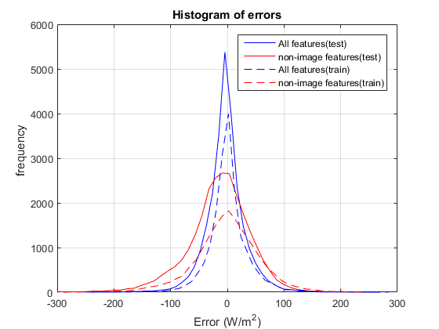
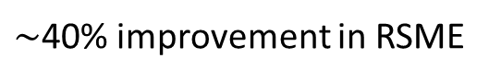
Errors
 | KNN | Linear Regression | SVR
RMSE (no image) | 57.2 | 60.7 | 62.7
RMSE (both) | 34.8 | 44.7 | 38.0
$\sim$40% improvement in RSME
KNN error histogram

Slide 17
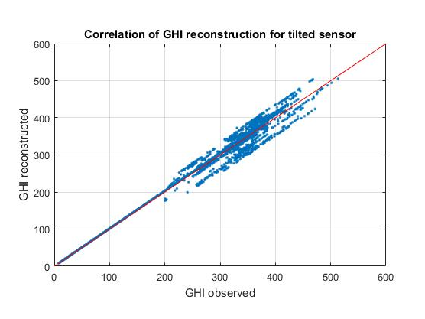
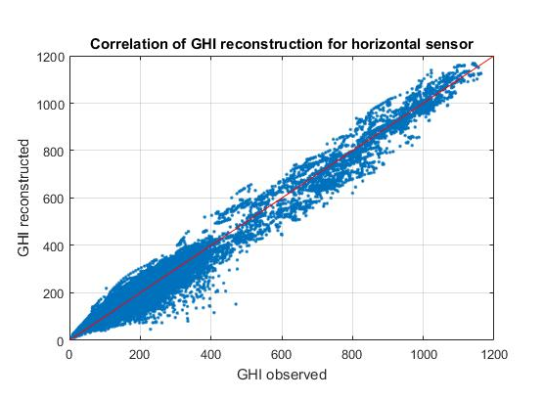
Constructing GHI

Slide 18
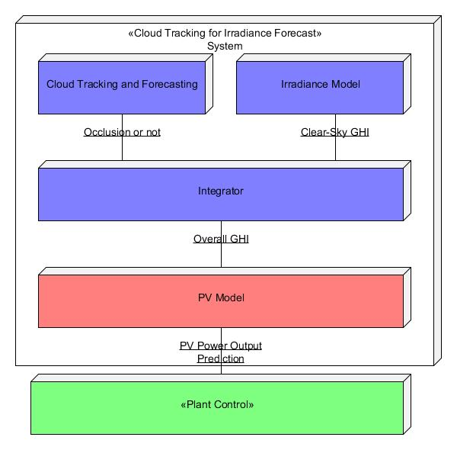
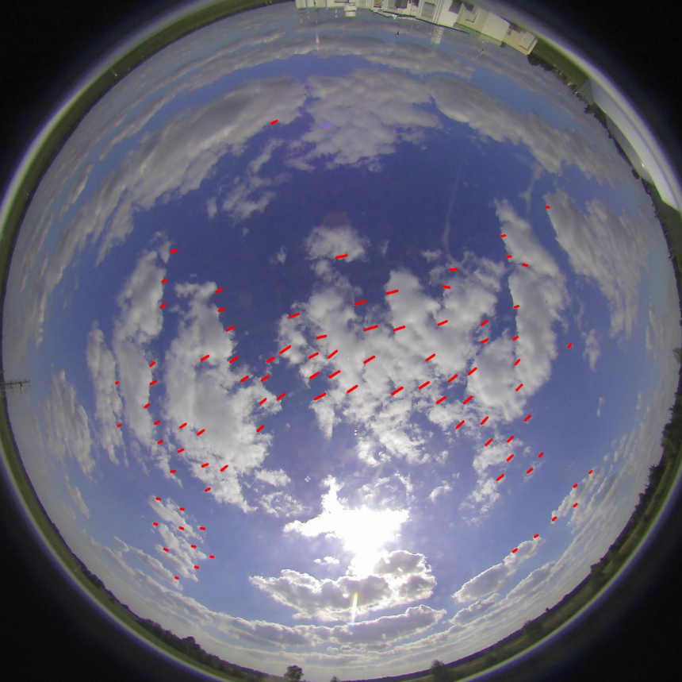
Application in irradiance forecast
Notes:
Using optical flow to extract clouds’ motion vector
Move the clouds with same motion vector

Slide 19
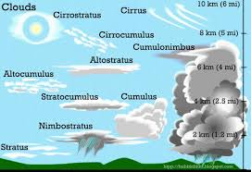
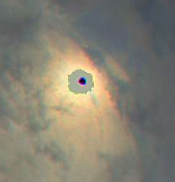
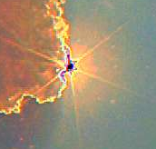
Future work
Consider partial sun occlusion
Cloud type classification

Slide 20
Conclusion
Estimate diffuse irradiance from sky images
Using machine learning on image and non-image features
Improved RMSE by 40% (35 W/m^2)

